Slide 1
User Manual
Student Course Registration Application
Team-1 Aug 1st. 2020

Slide 2
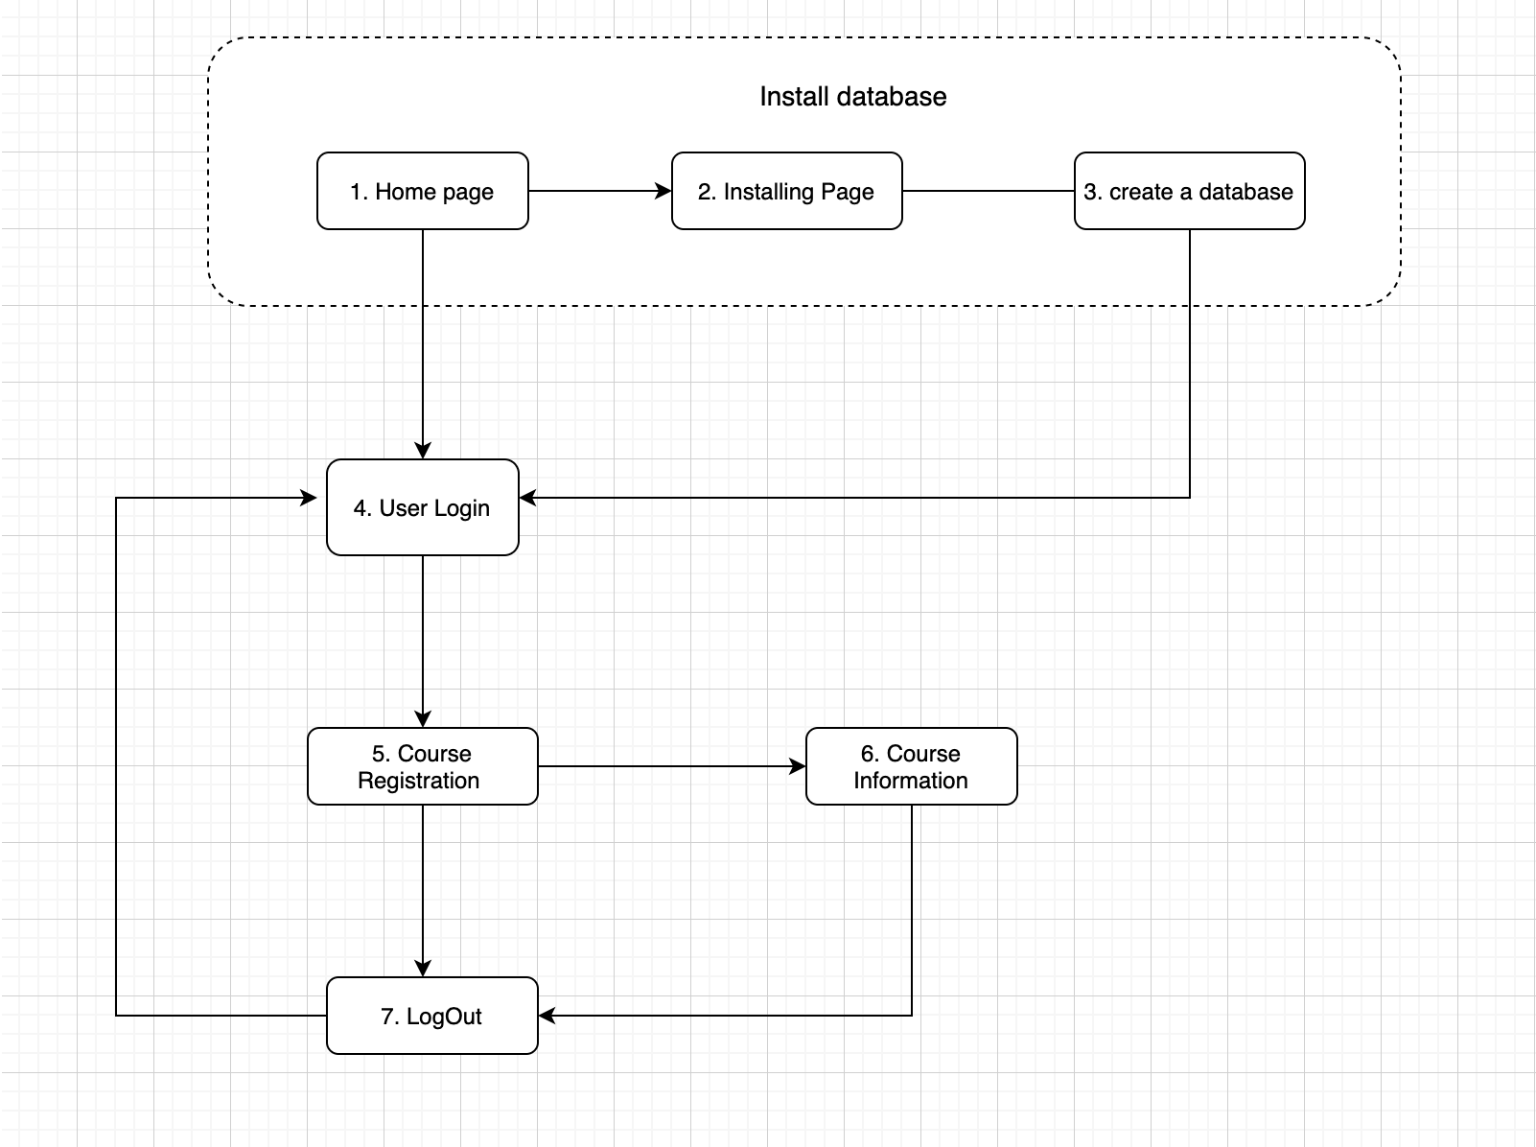
Main user flow chart
Our database consists of five entities, but our fully implemented CRUD are only for students, student_courses and tuition
Student_Courses
Students
Tuition
Courses (read-only)
Instructors (read-only)

Slide 3
Instructions
Description: This web app will serve as a course registration platform for students.
In order to launch the web app, open /Team1.php

Slide 4
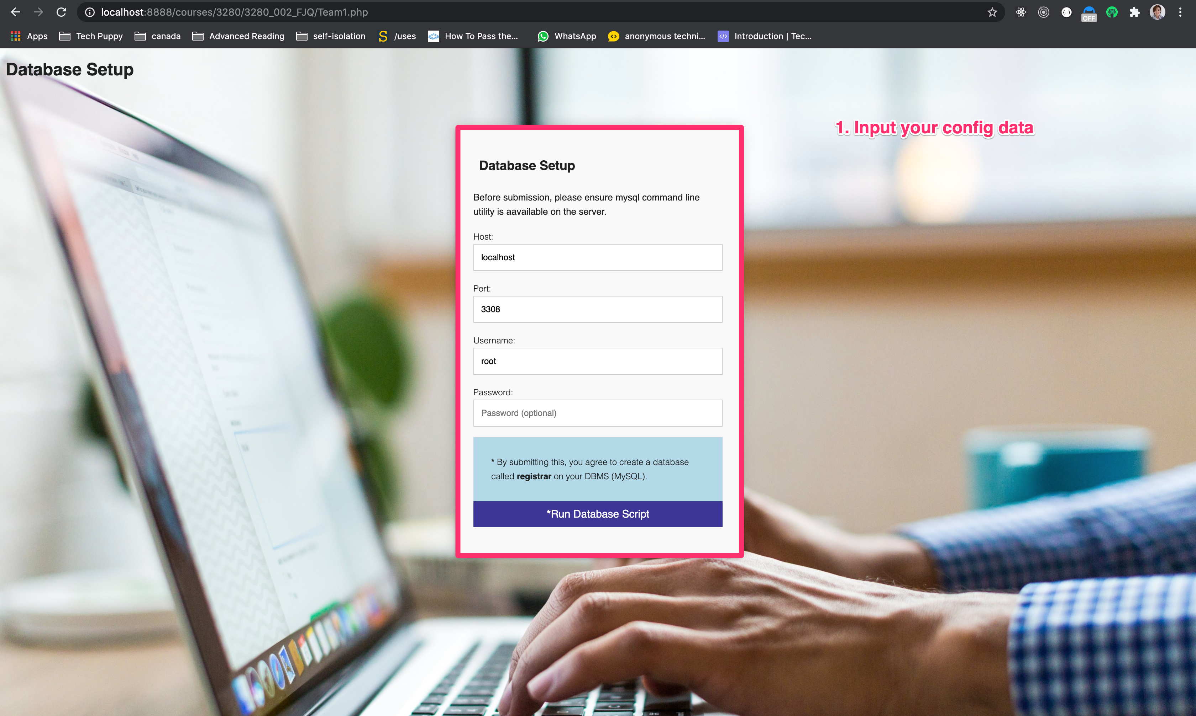
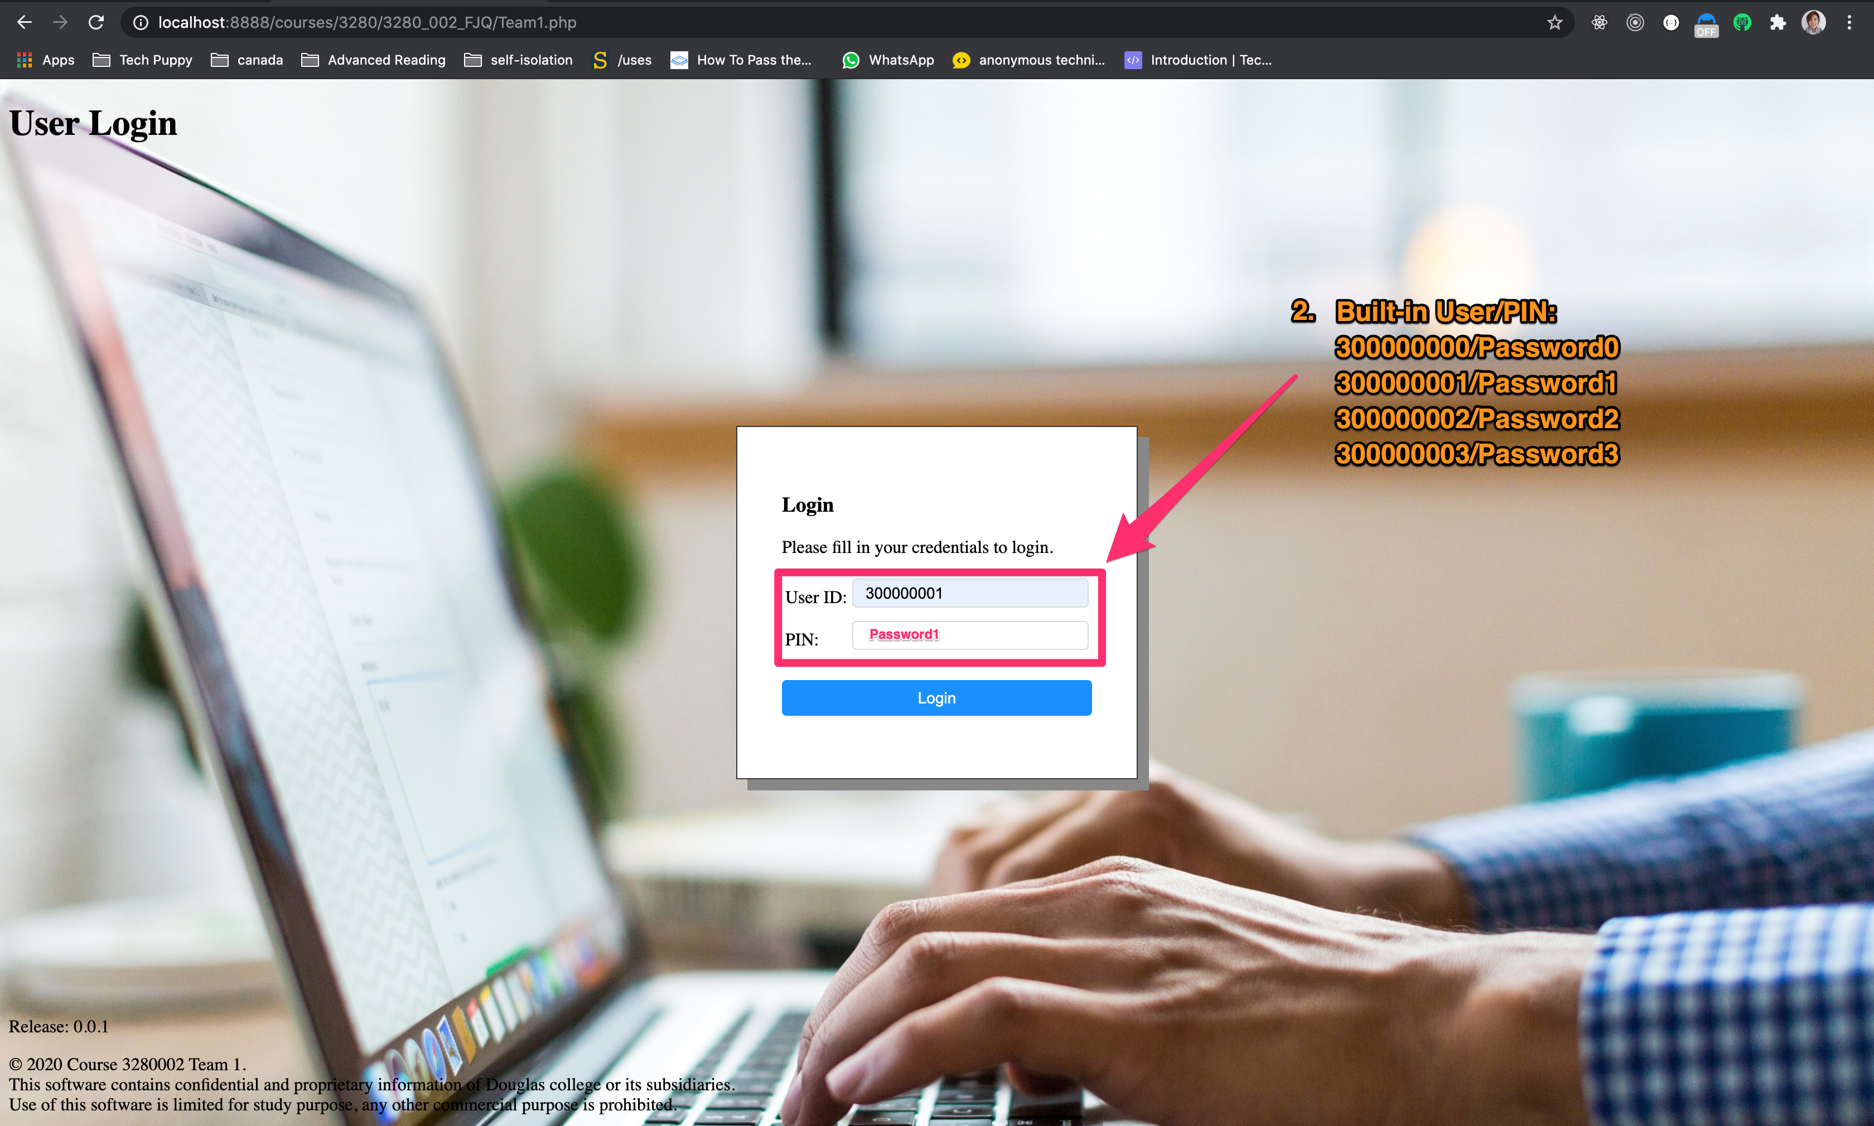
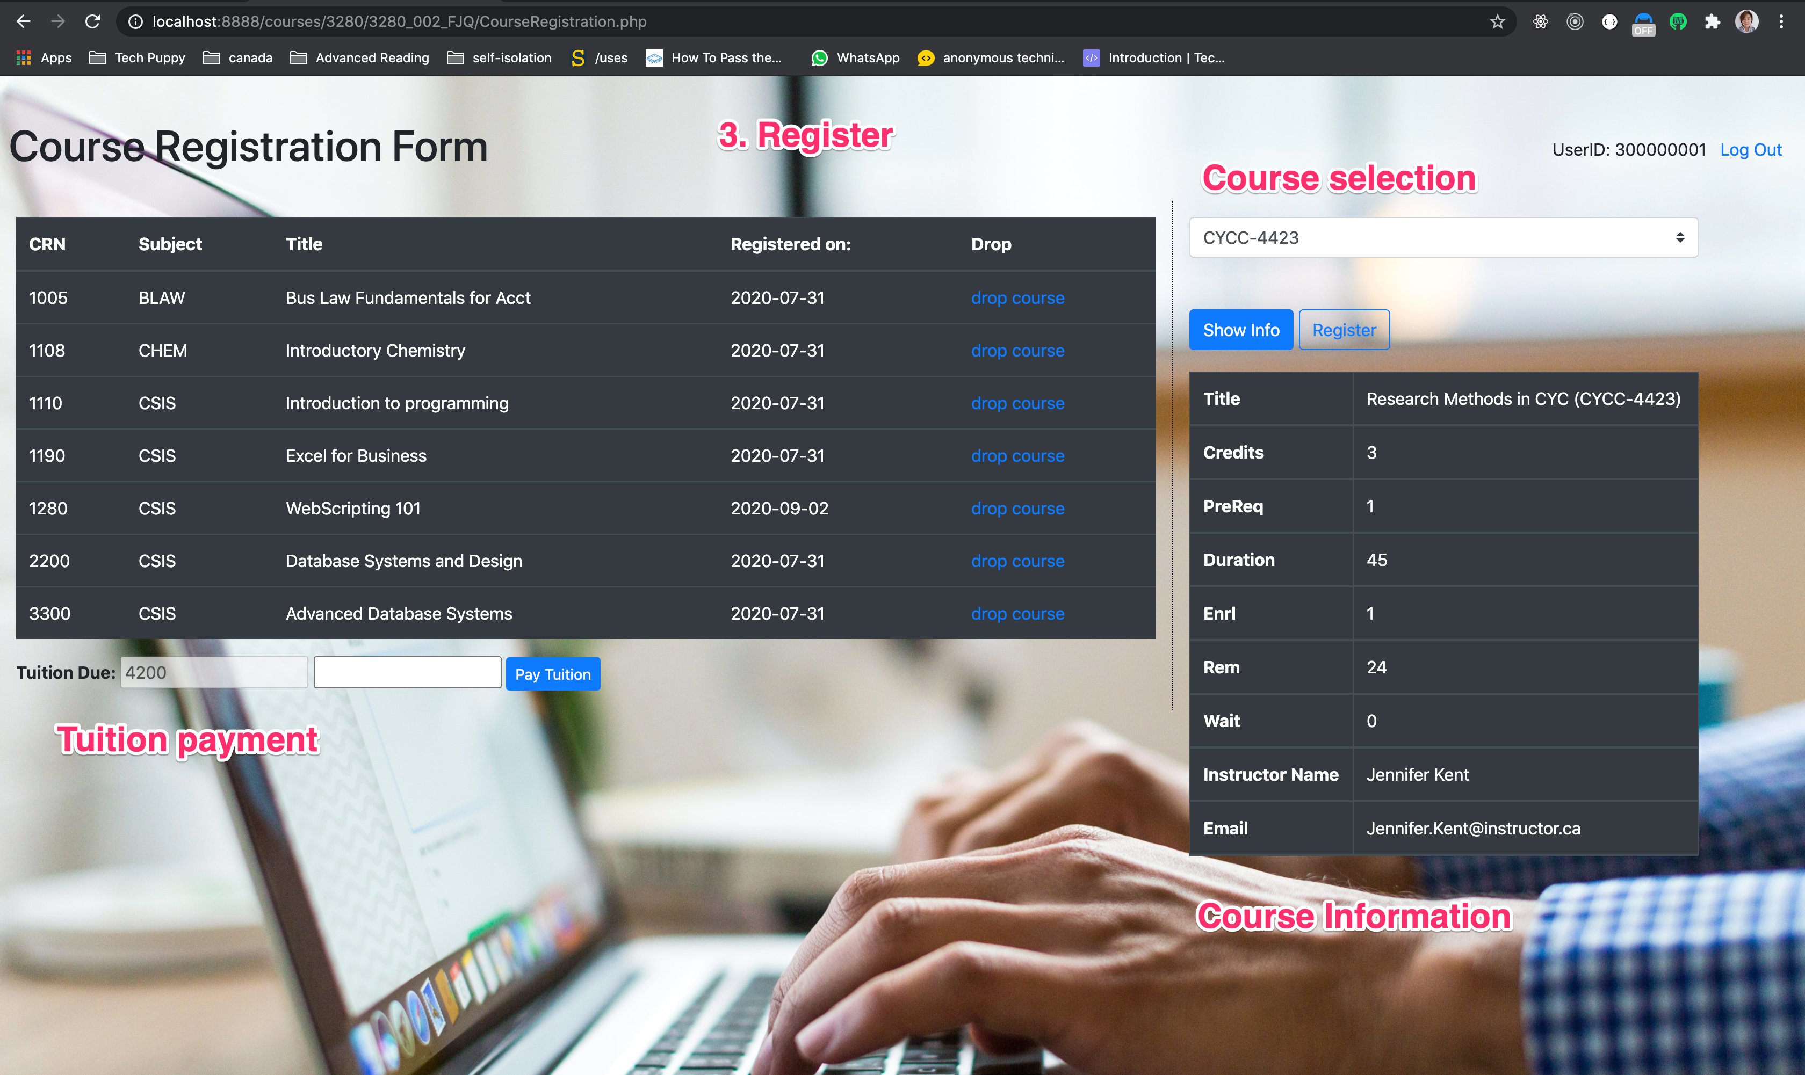

Getting Started
2. Built-in User/PIN:
300000000/Password0
300000001/Password1
300000002/Password2
300000003/Password3

